Slide 1
JAVA APPLET

Slide 2
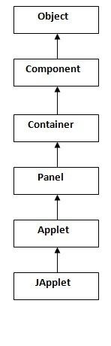
Applet is a special type of program that is embedded in the webpage to generate the dynamic content. It runs inside the browser and works at client side.
Advantage of Applet
There are many advantages of applet. They are as follows:
It works at client side so less response time.
Secured
It can be executed by browsers running under many platforms, including Linux, Windows, Mac Os etc.
Drawback of Applet
Plugin is required at client browser to execute applet.
Hierarchy of Applet

Slide 3
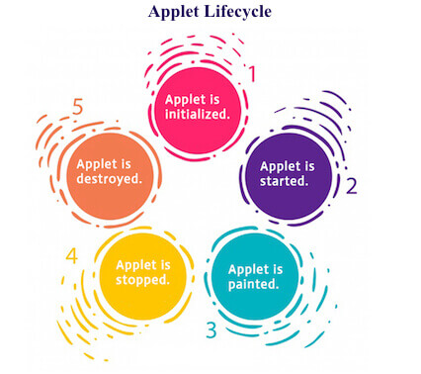
Lifecycle of Java Applet
Applet is initialized.
Applet is started.
Applet is painted.
Applet is stopped.
Applet is destroyed.
Lifecycle methods for Applet:
The java.applet.Applet class 4 life cycle methods and java.awt.Component class provides 1 life cycle methods for an applet.
java.applet.Applet class
For creating any applet java.applet.Applet class must be inherited. It provides 4 life cycle methods of applet.
public void init(): is used to initialized the Applet. It is invoked only once.
public void start(): is invoked after the init() method or browser is maximized. It is used to start the Applet.
public void stop(): is used to stop the Applet. It is invoked when Applet is stop or browser is minimized.
public void destroy(): is used to destroy the Applet. It is invoked only once.

Slide 4
java.awt.Component class
The Component class provides 1 life cycle method of applet.
public void paint(Graphics g): is used to paint the Applet. It provides Graphics class object that can be used for drawing oval, rectangle, arc etc.
Commonly used methods of Graphics class:
public abstract void drawString(String str, int x, int y): is used to draw the specified string.
public void drawRect(int x, int y, int width, int height): draws a rectangle with the specified width and height.
public abstract void fillRect(int x, int y, int width, int height): is used to fill rectangle with the default color and specified width and height.
public abstract void drawOval(int x, int y, int width, int height): is used to draw oval with the specified width and height.
public abstract void fillOval(int x, int y, int width, int height): is used to fill oval with the default color and specified width and height.
public abstract void drawLine(int x1, int y1, int x2, int y2): is used to draw line between the points(x1, y1) and (x2, y2).
public abstract boolean drawImage(Image img, int x, int y, ImageObserver observer): is used draw the specified image.
public abstract void drawArc(int x, int y, int width, int height, int startAngle, int arcAngle): is used draw a circular or elliptical arc.
public abstract void fillArc(int x, int y, int width, int height, int startAngle, int arcAngle): is used to fill a circular or elliptical arc.
public abstract void setColor(Color c): is used to set the graphics current color to the specified color.
public abstract void setFont(Font font): is used to set the graphics current font to the specified font.

Slide 5
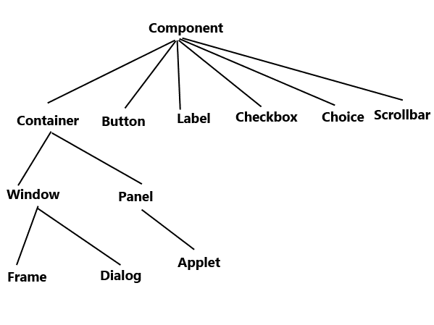
AWT hierarchy
Types of containers
There are in total, four types of containers available in AW, that is, Window, Frame, Dialog, and Panel. As shown in the hierarchy above, Frame and Dialog are subclasses of Window class.
1. Window: The window is a container which does not have borders and menu bars. In order to create a window, you can use frame, dialog or another window.
2. Panel: The Panel is the container/class that doesn’t contain the title bar and menu bars. It has other components like button, text field, etc.
3. Dialog: The Dialog is the container or class having border and title. We cannot create an instance of the Dialog class without an associated instance of the respective Frame class.

Slide 6
< APPLET
[CODEBASE = codebaseURL]
CODE = appletFile
[ALT = alternateText]
[NAME = appletInstanceName]
WIDTH = pixels HEIGHT = pixels
[ALIGN = alignment ]
[VSPACE = pixels] [HSPACE = pixels]
>
[< PARAM NAME = AttributeName VALUE = AttributeValue>]
[< PARAM NAME = AttributeName2 VALUE = AttributeValue>]
. . .
[HTML Displayed in the absence of Java]
</APPLET>

Slide 7
getDocumentBase( ) and getCodeBase( )
Java will allow the applet to load data from the directory holding the HTML file that started the applet (the document base) and the directory from which the applet’s class file was loaded (the code base).
These directories are returned as URL objects by getDocumentBase( ) and getCodeBase( ). They can be concatenated with a string that names the file you want to load. To actually load another file, you will use the showDocument( ) method defined by the AppletContext interface, discussed in the next section.

